Slide 1

Azure Services & Service Fabric
Abdul Rasheed Feroz Khan
Director – Code$izzler
Twitter - @TechFero | @CodeSizzler
www.codesizzler.com
#CodeSizzler | #AzureServiceFabric

Slide 2
Create and deploy an application with an ASP.NET Core Web API front-end service and a stateful back-end service
Notes:
This tutorial is part one of a series. You will learn how to create an Azure Service Fabric application with an ASP.NET Core Web API front end and a stateful back-end service to store your data.

Slide 3
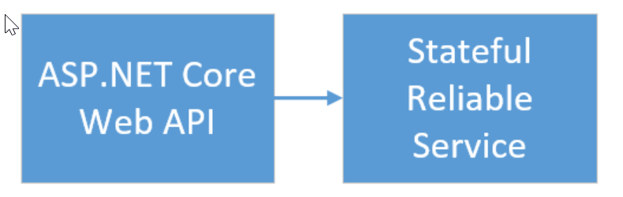

Slide 4
Requirements:
Azure subscription
Visual Studio 2017 with Azure SDK – ASP.NET web deployment workloads
Service Fabric SDK

Slide 5
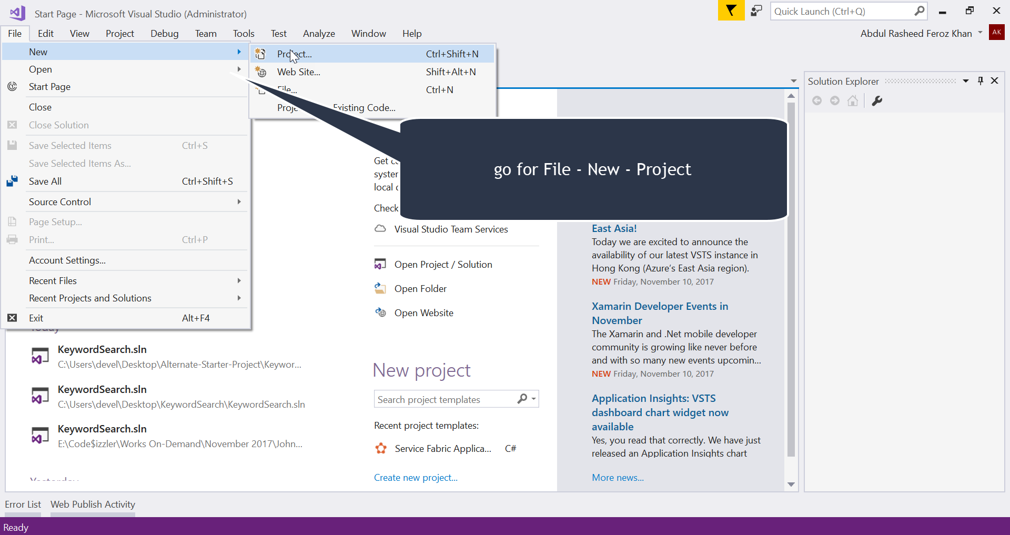

Slide 6
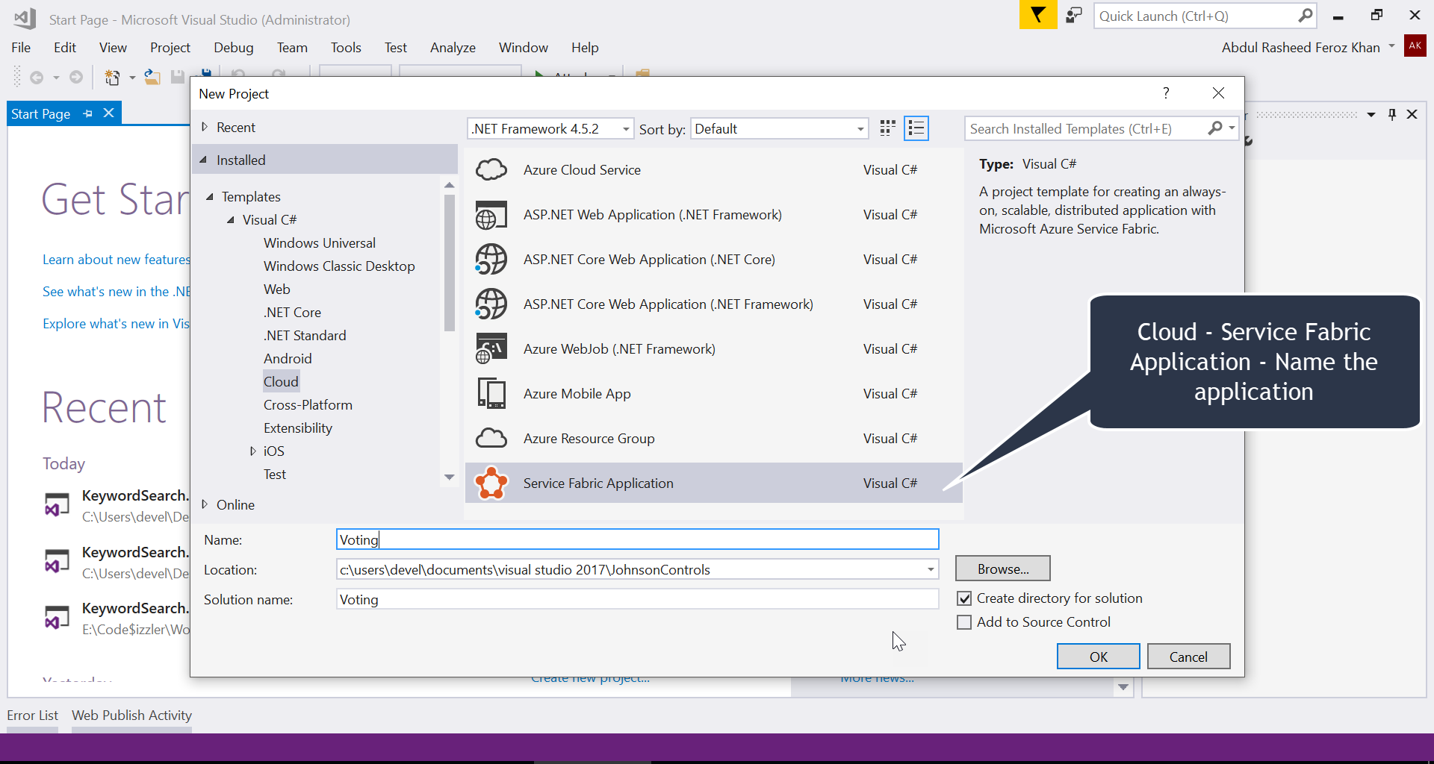

Slide 7
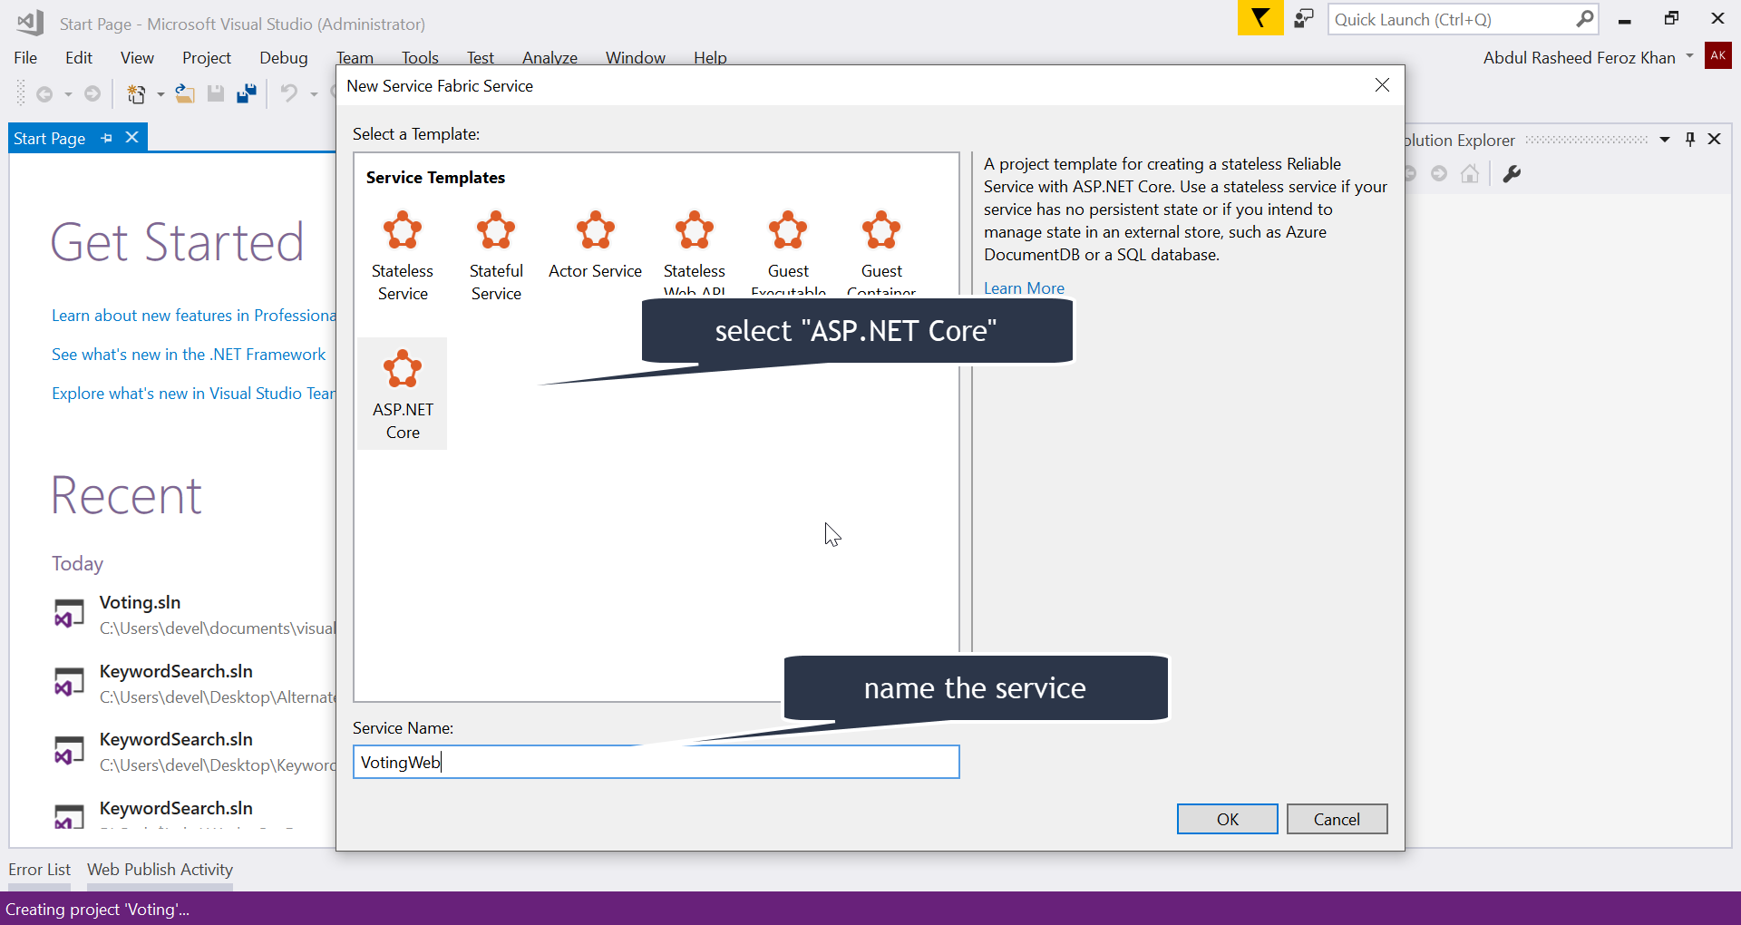

Slide 8
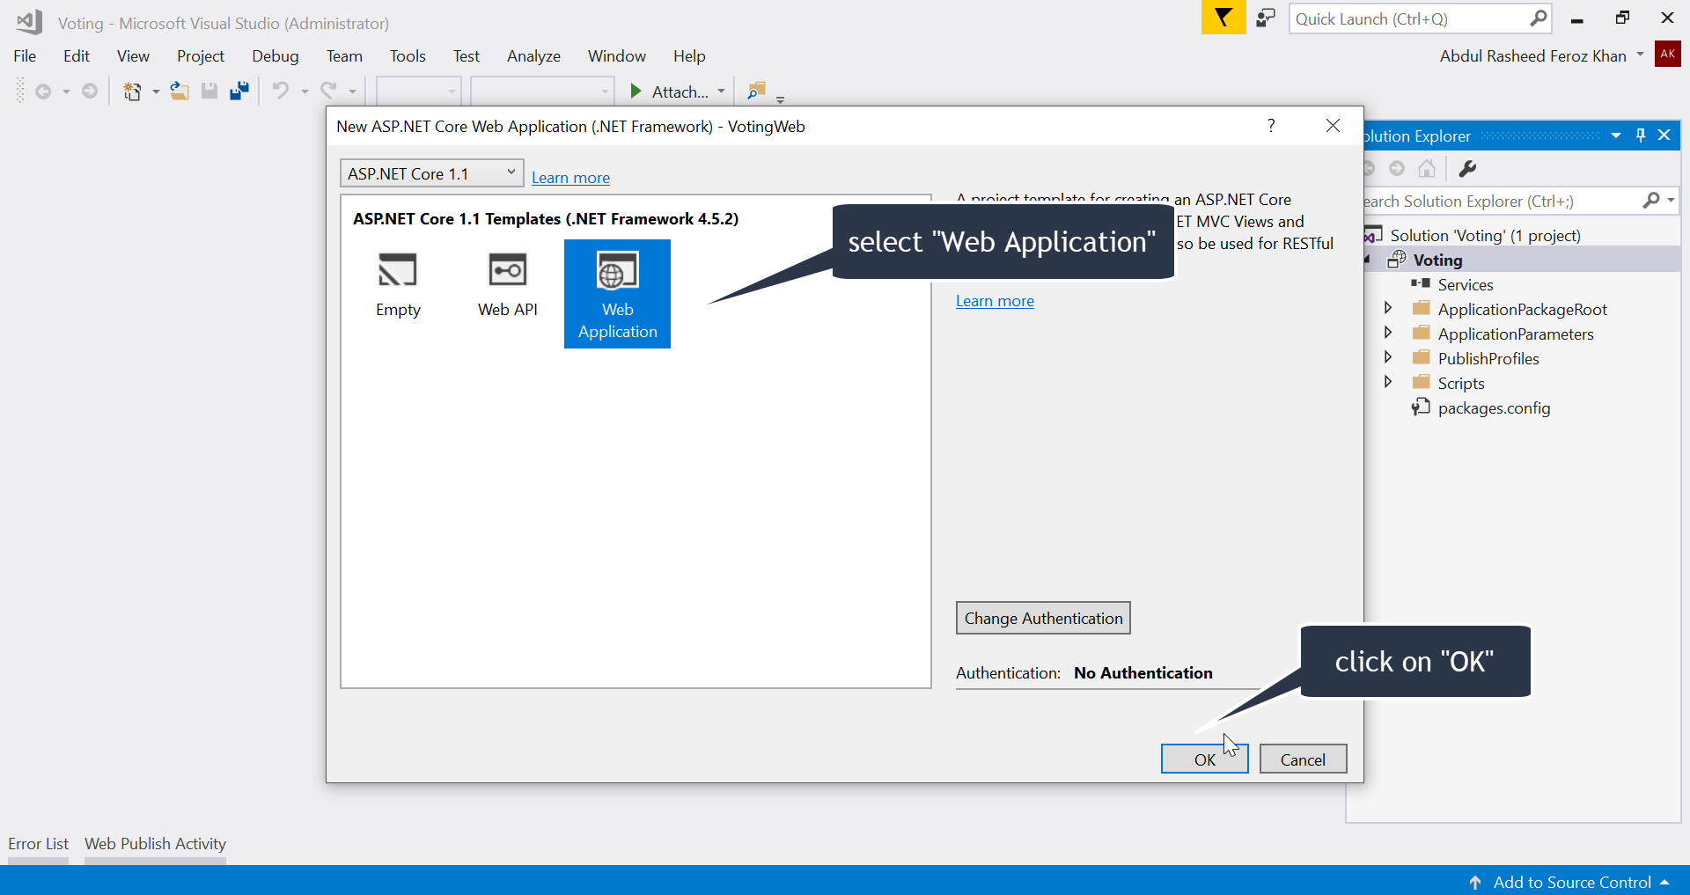

Slide 9
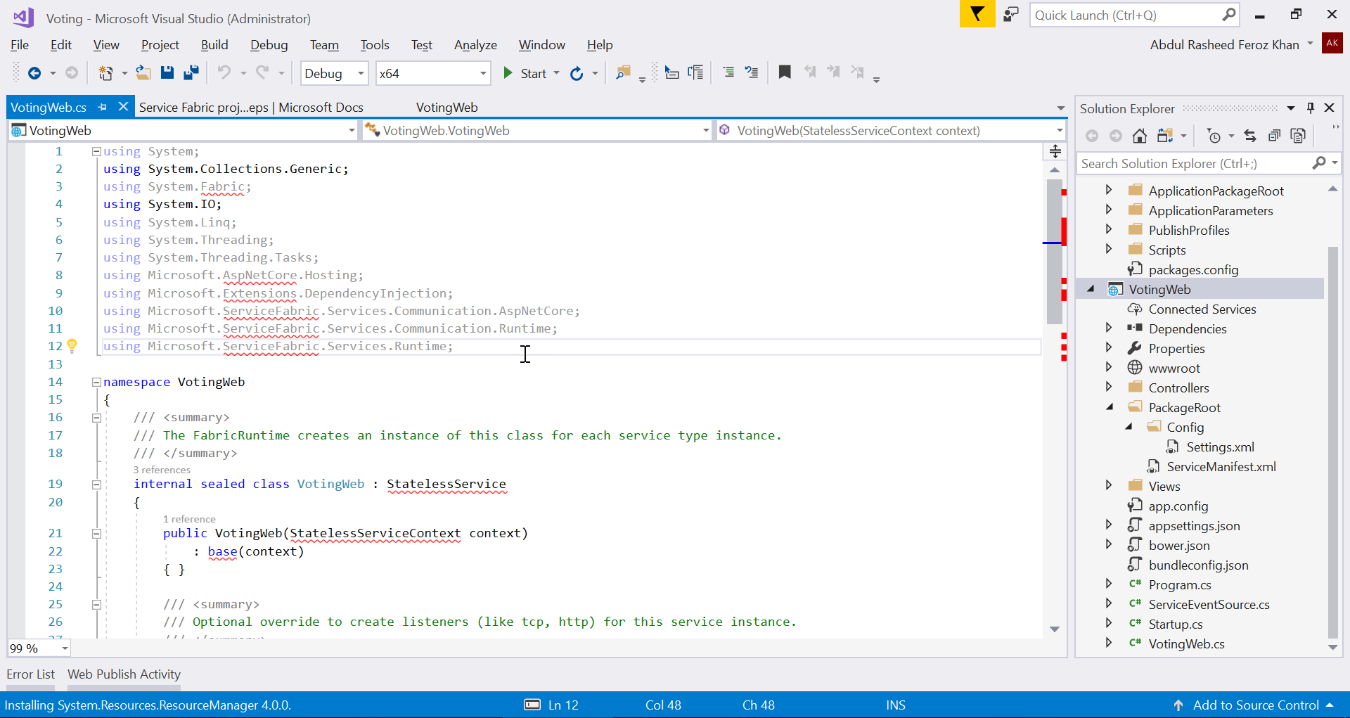

Slide 10
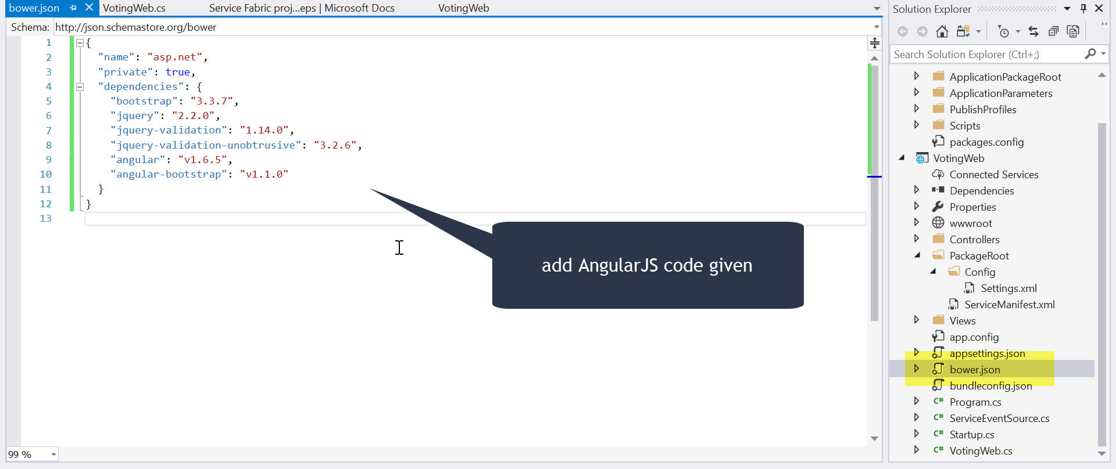

Slide 11
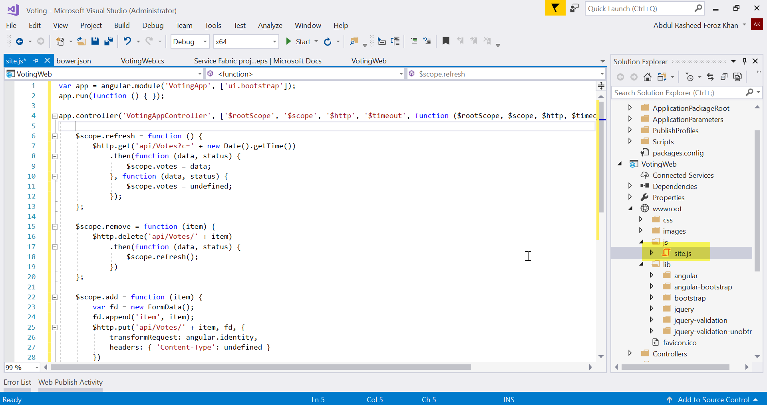
Notes:
Open the wwwroot/js/site.js file. Replace its contents with the JavaScript used by the Home views

Slide 12
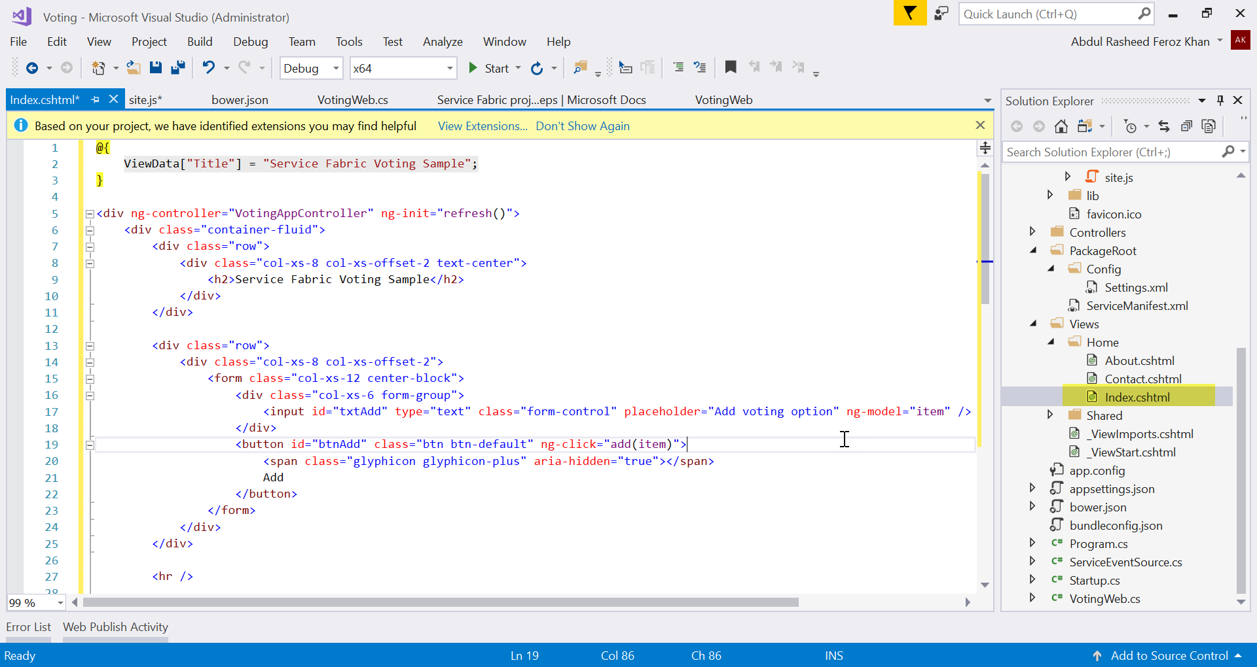
Notes:
Open the Views/Home/Index.cshtml file, the view specific to the Home controller. Replace its contents with the following, then save your changes.

Slide 13
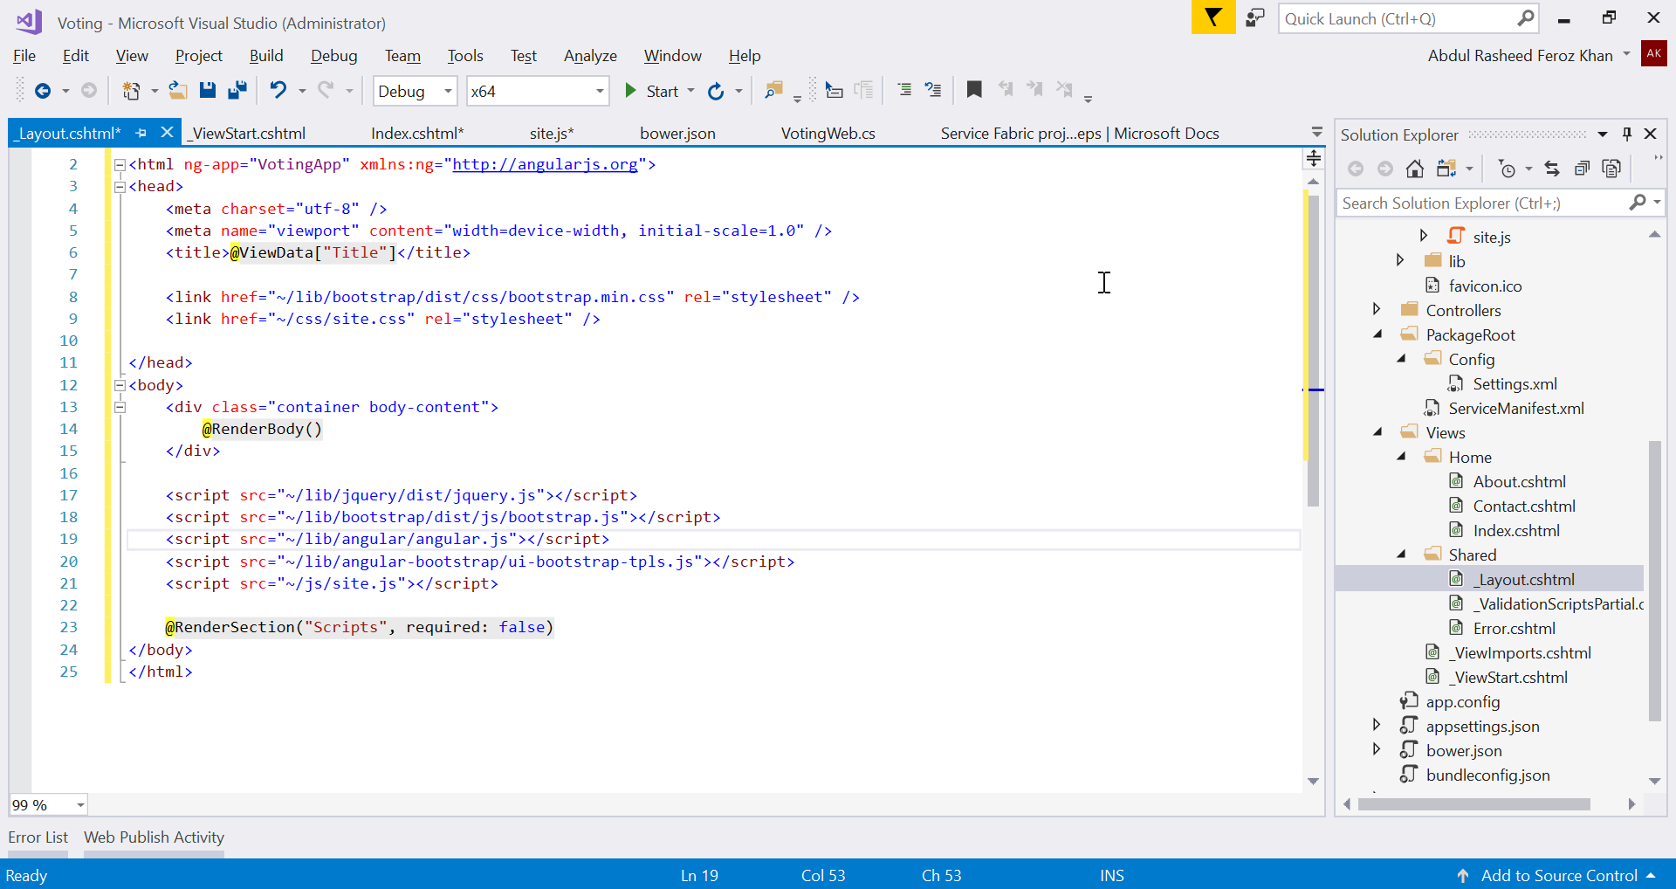
Notes:
Open the Views/Shared/_Layout.cshtml file, the default layout for the ASP.NET app. Replace its contents with the following, then save your changes.

Slide 14
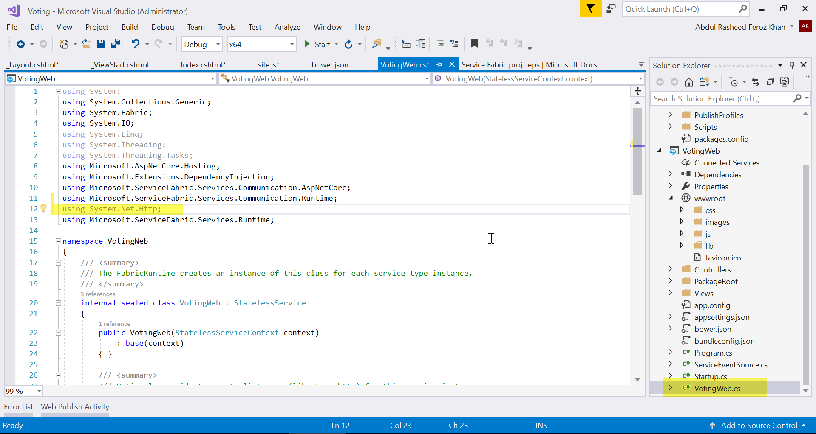
Notes:
Open the VotingWeb.cs file, which creates the ASP.NET Core WebHost inside the stateless service using the WebListener web server.
Add the using System.Net.Http; directive to the top of the file.
Replace the CreateServiceInstanceListeners() function with the following, then save your changes.

Slide 15
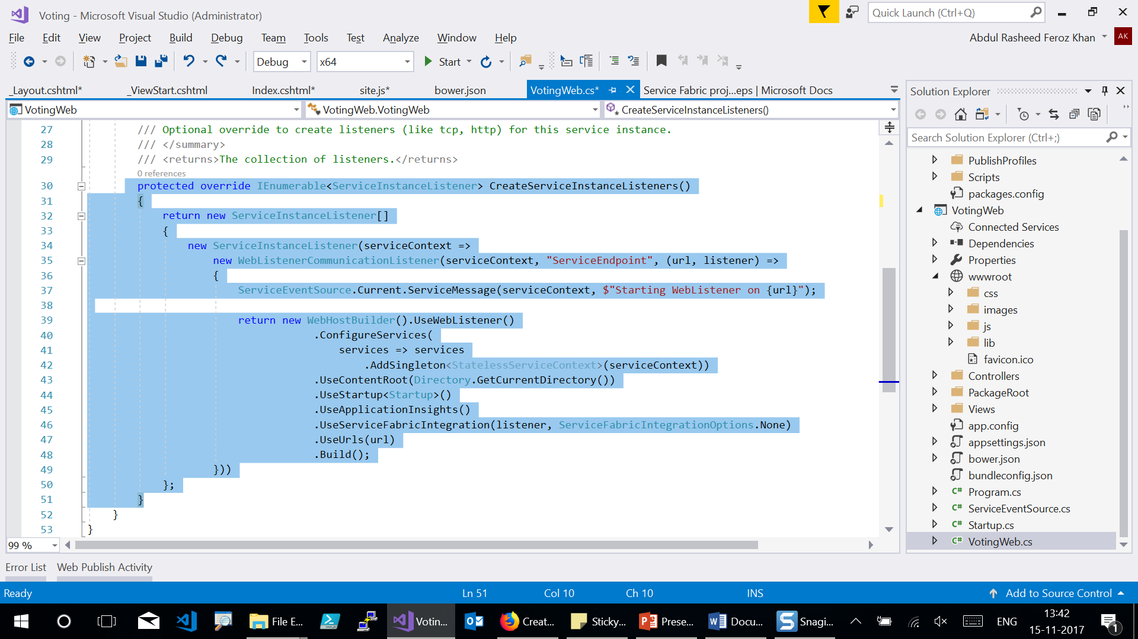

Slide 16
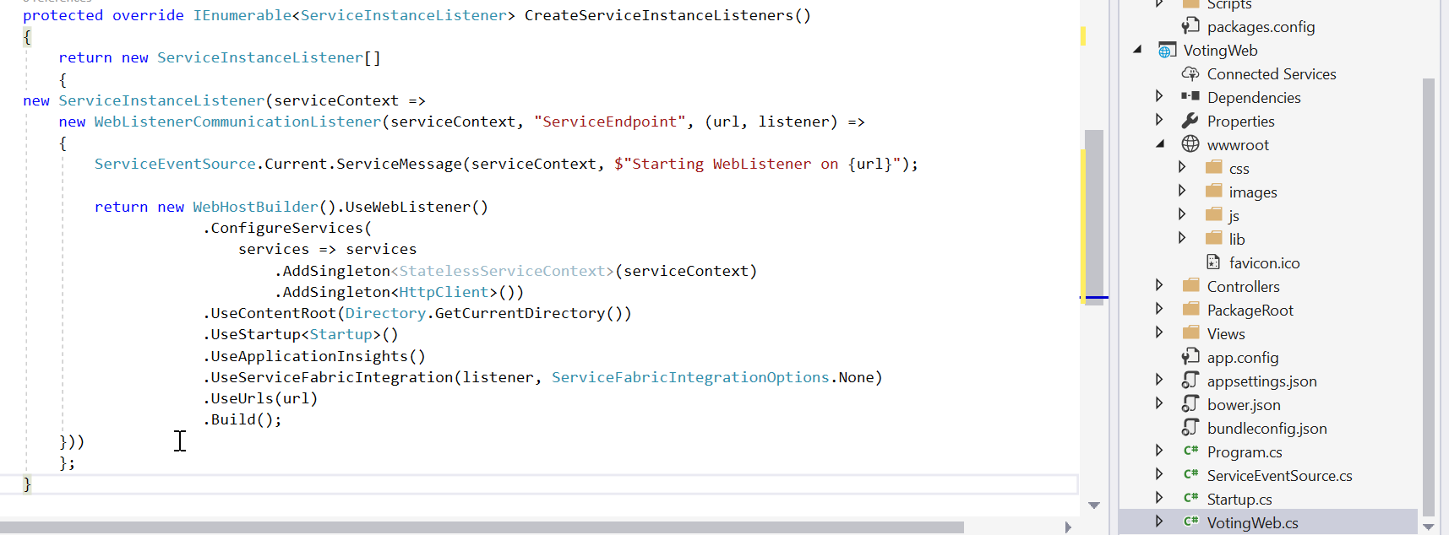

Slide 17
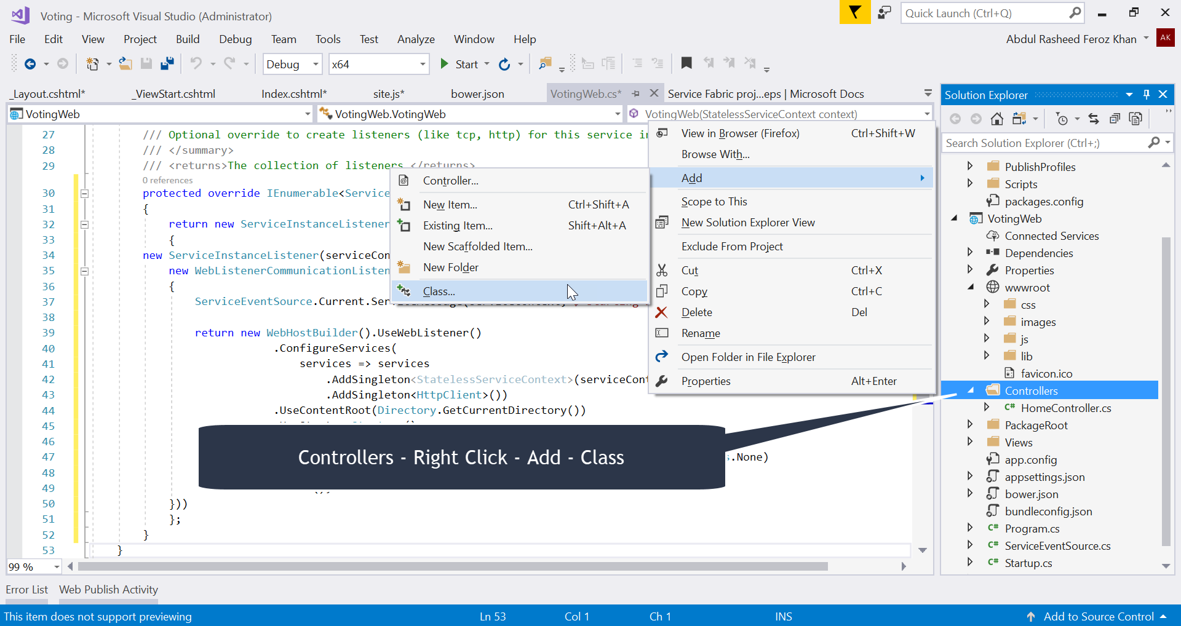
Notes:
Add the VotesController.cs file
Add a controller which defines voting actions. Right-click on the Controllers folder, then select Add->New item->Class. Name the file "VotesController.cs" and click Add.
Replace the file contents with the following, then save your changes. Later, in Update the VotesController.cs file, this file will be modified to read and write voting data from the back-end service. For now, the controller returns static string data to the view.

Slide 18
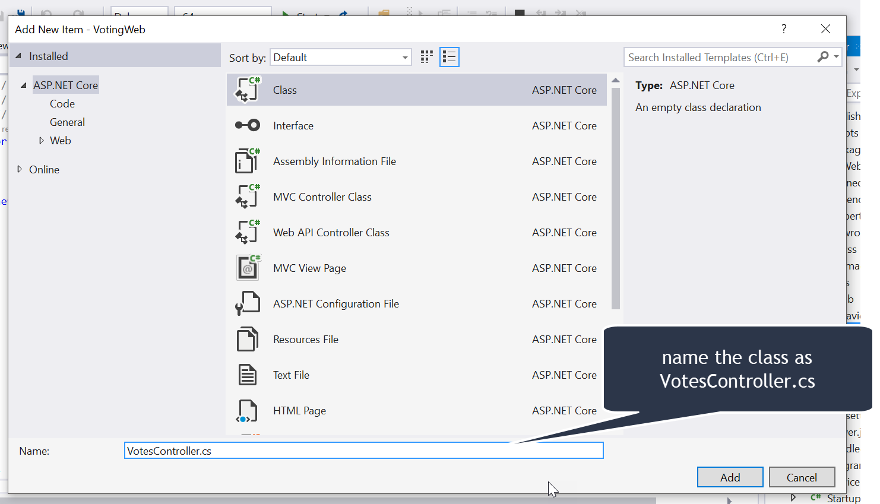

Slide 19
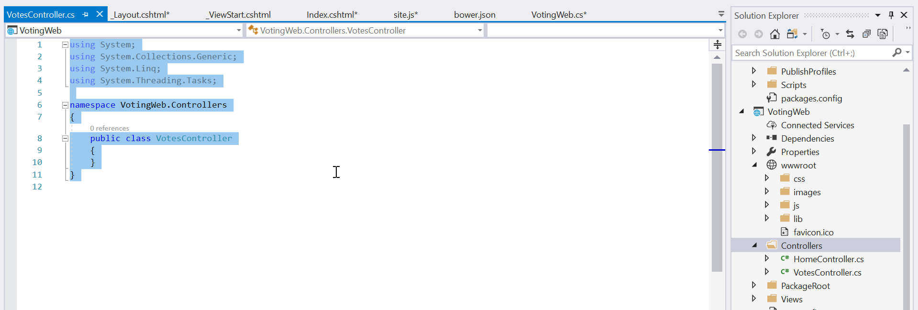

Slide 20
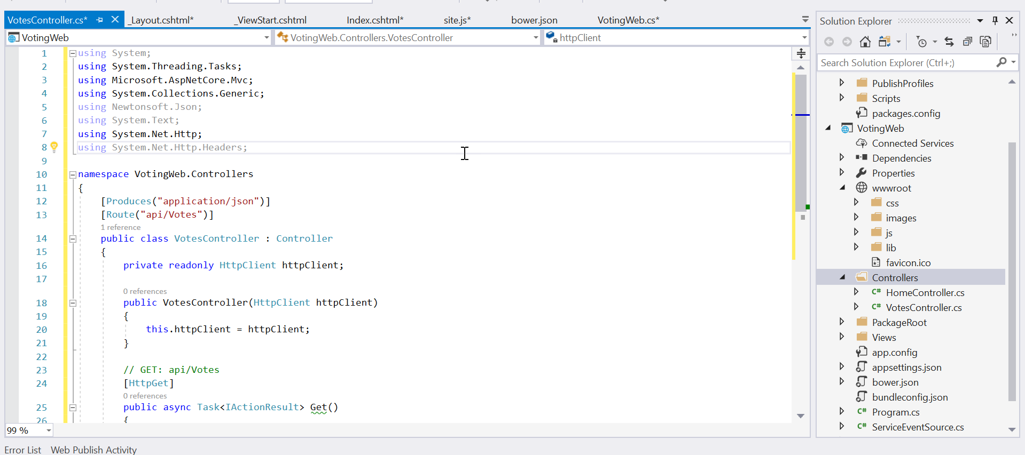

Slide 21
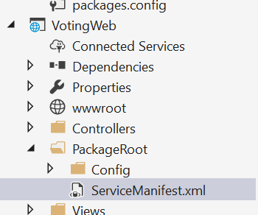
Notes:
Configure the listening port
When the VotingWeb front-end service is created, Visual Studio randomly selects a port for the service to listen on. The VotingWeb service acts as the front-end for this application and accepts external traffic, so let's bind that service to a fixed and well-know port. In Solution Explorer, open VotingWeb/PackageRoot/ServiceManifest.xml. Find the Endpoint resource in the Resources section and change the Port value to 80, or to another port. To deploy and run the application locally, the application listening port must be open and available on your computer.

Slide 22
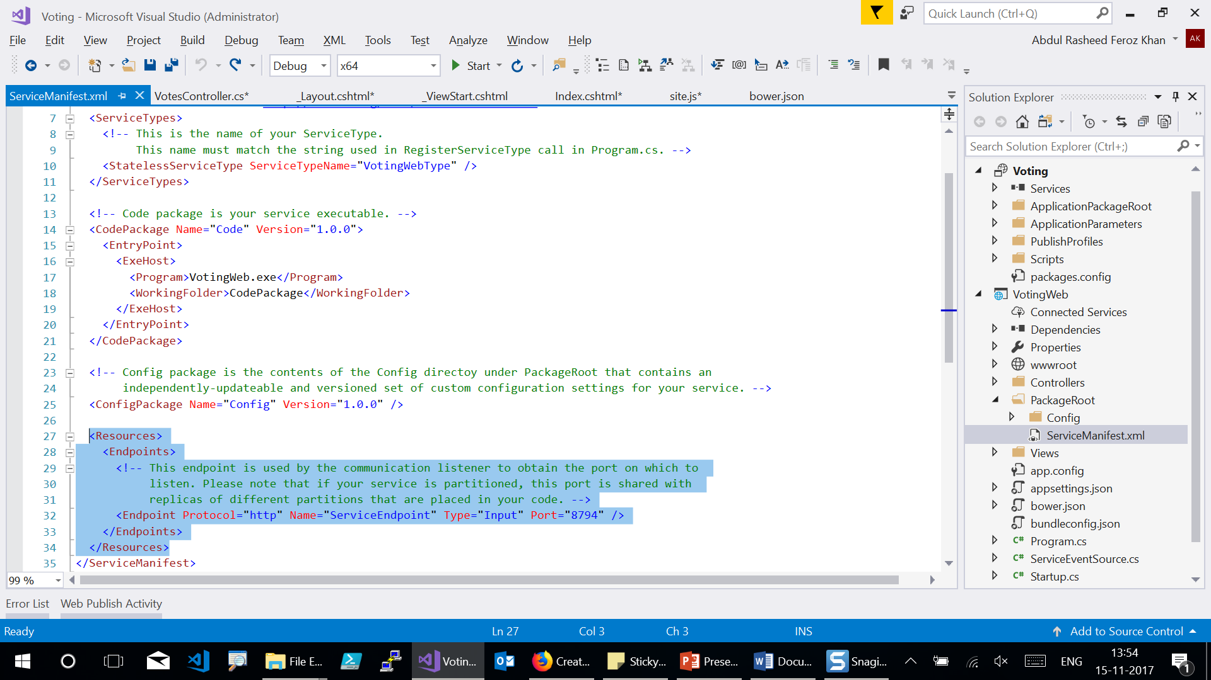

Slide 23
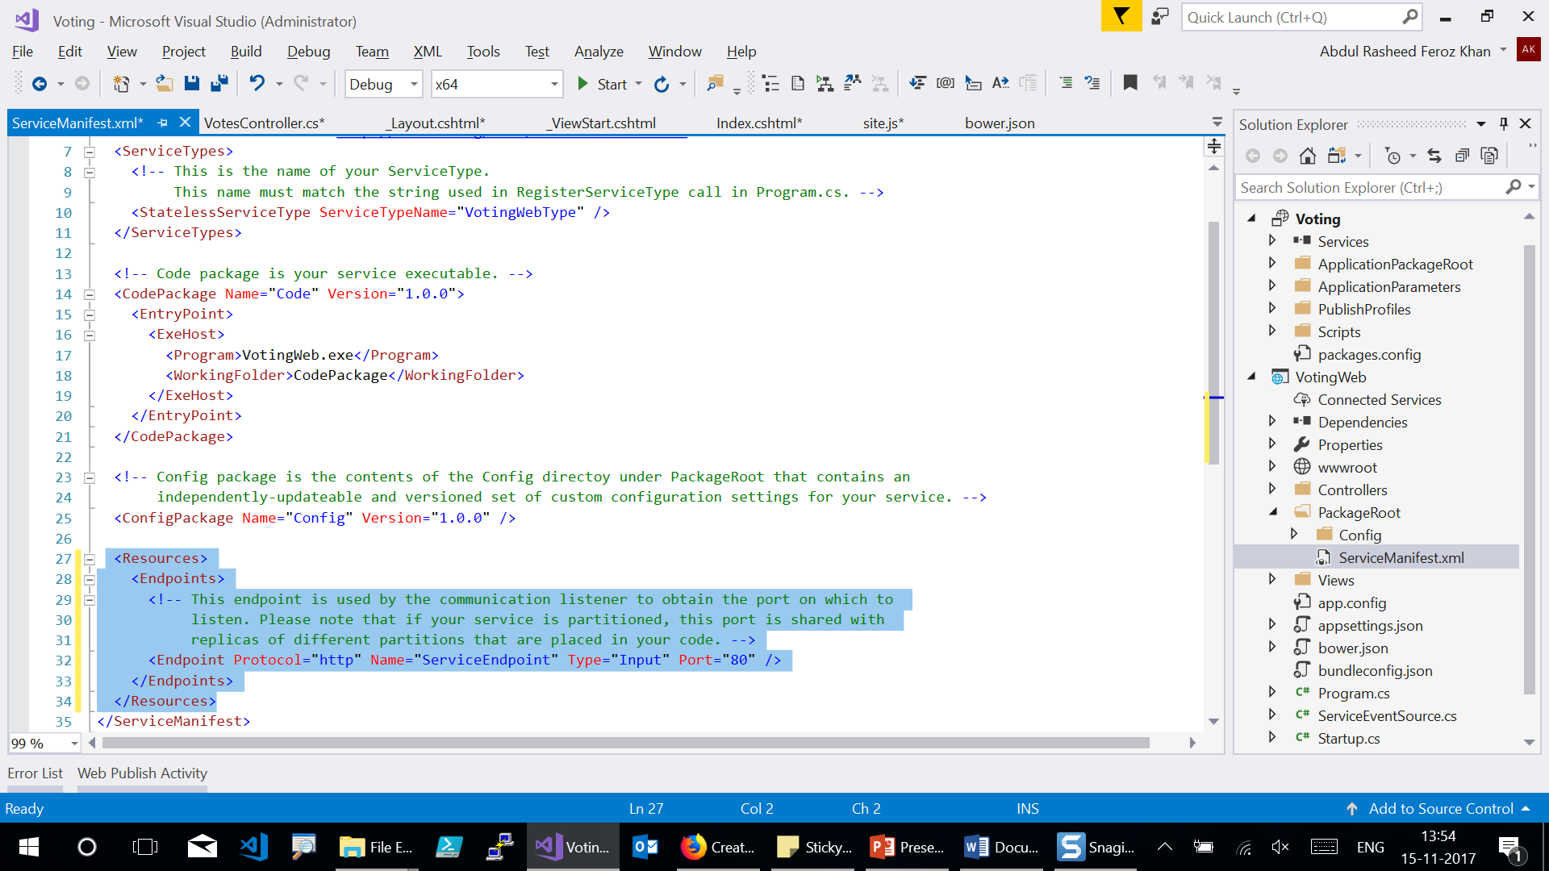

Slide 24
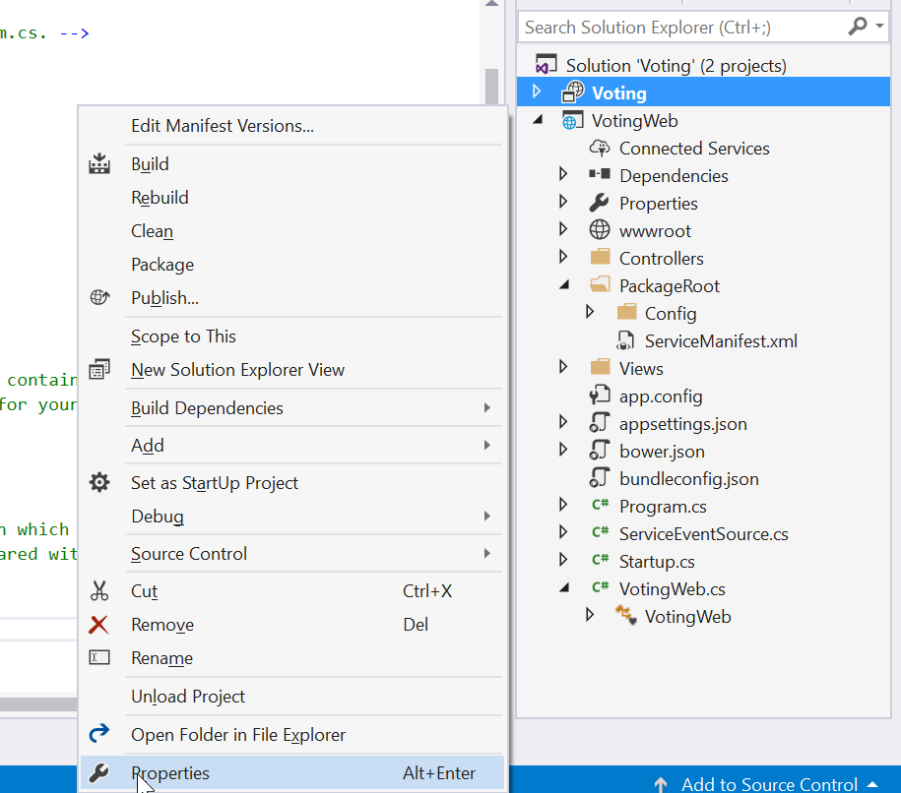
Notes:
Also update the Application URL property value in the Voting project so a web browser opens to the correct port when you debug using 'F5'. In Solution Explorer, select the Voting project and update the Application URL property.

Slide 25
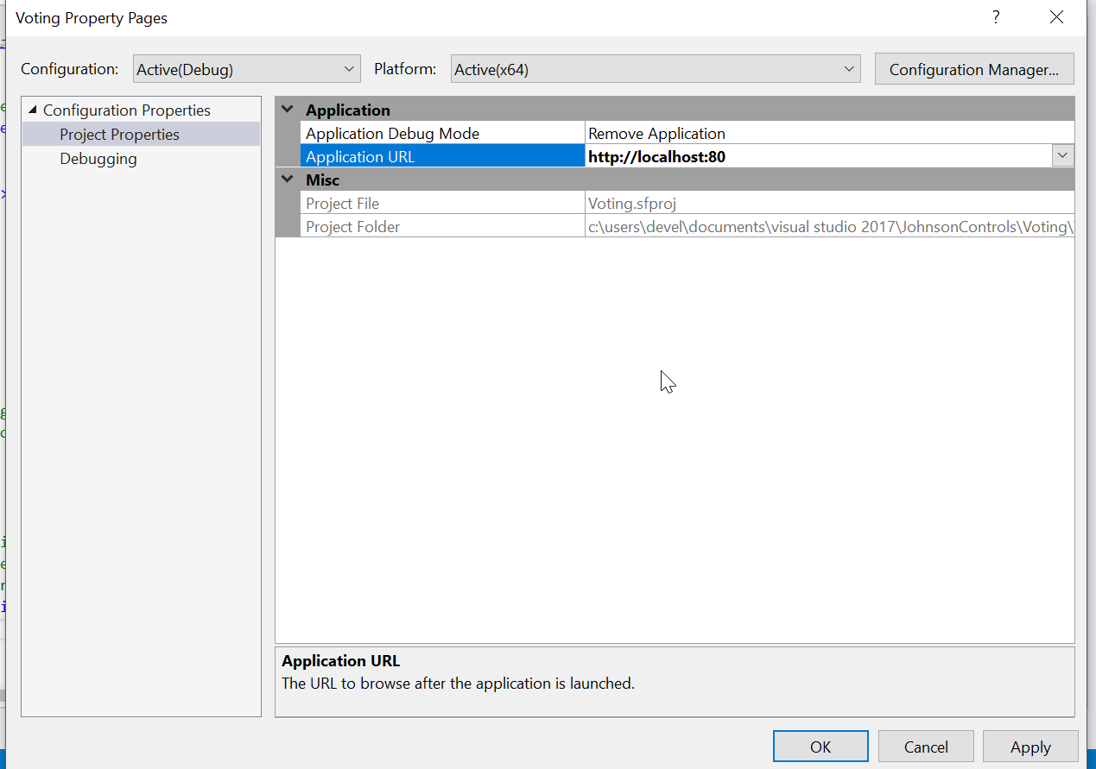
Notes:
Click on OK and press F5 to run the program. The first time you run and deploy the application locally, Visual Studio creates a local cluster for debugging. Cluster creation may take some time. The cluster creation status is displayed in the Visual Studio output window.

Slide 26
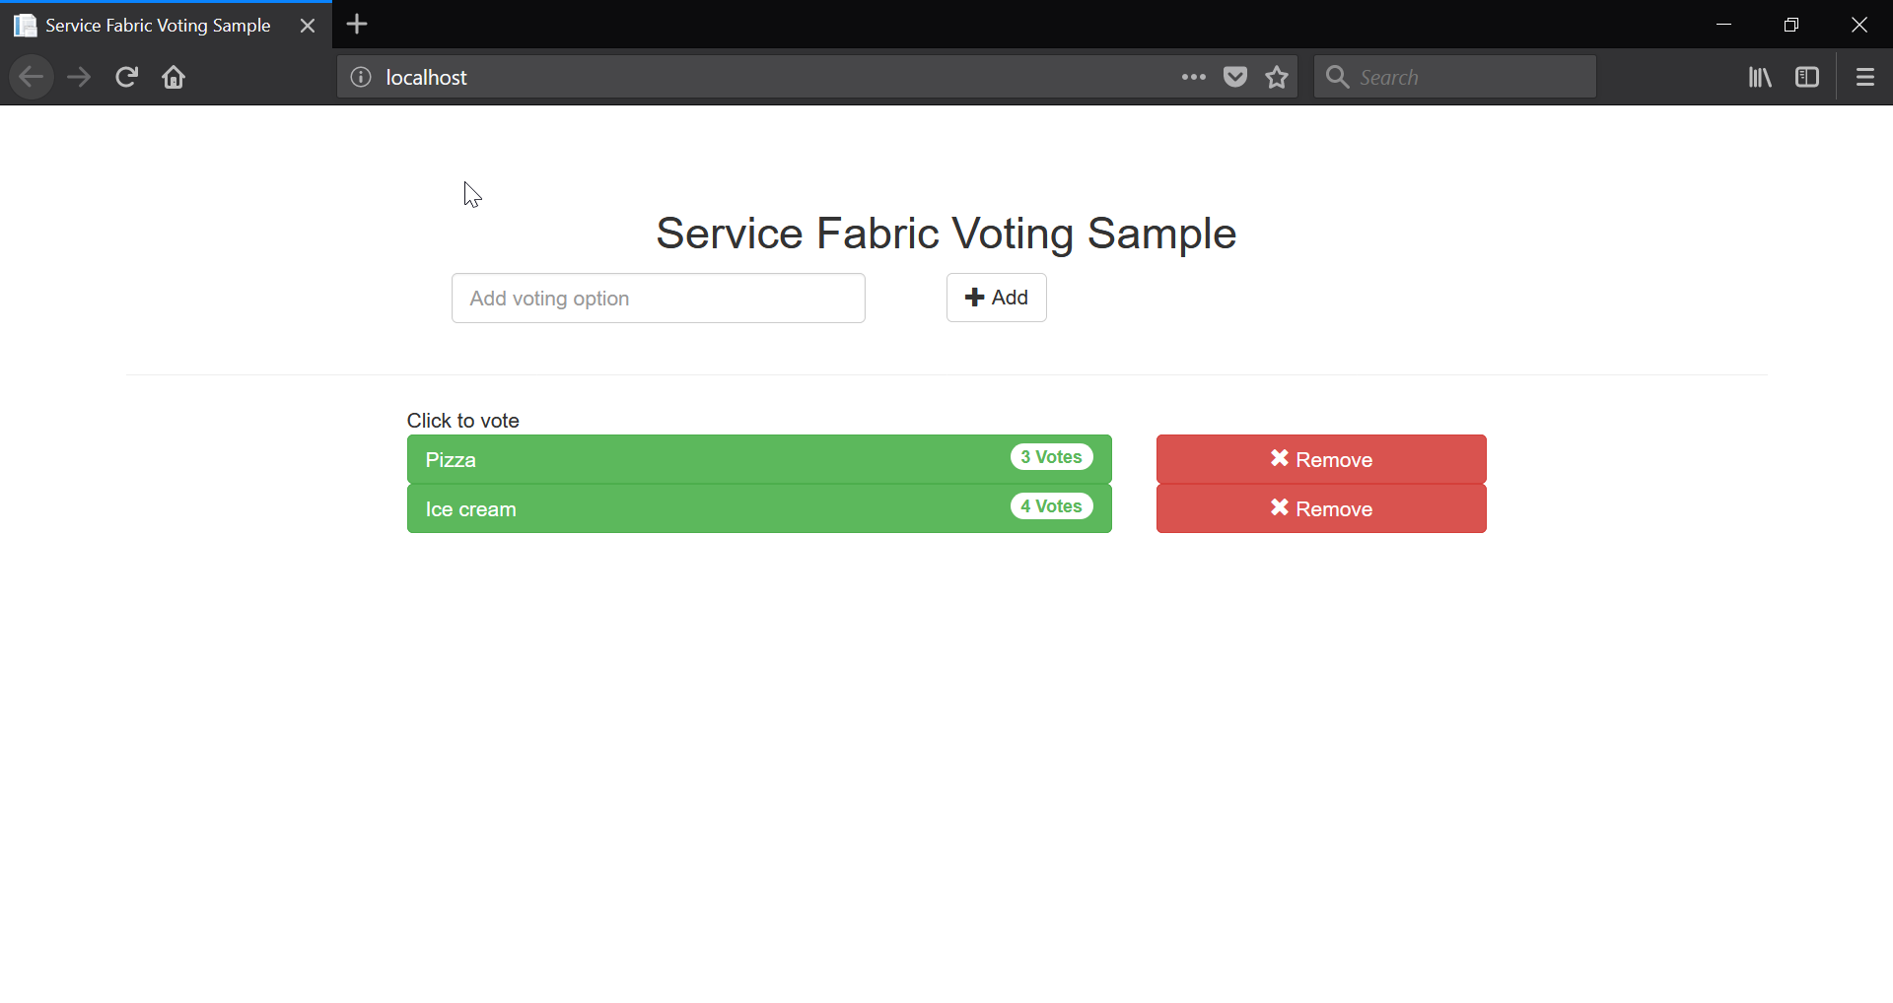

Slide 27


Enter Text
Write us for queries!!
Abdul Rasheed Feroz Khan
Feel free to reach me for any queries:
@TechFero | @CodeSizzler
developer.fero@outlook.com

